Slide 1
French festival with wine

Slide 2
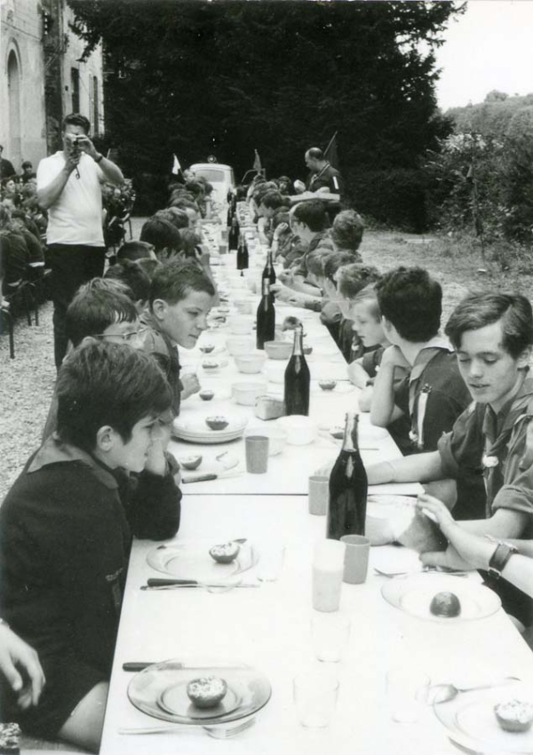
"Wine" plays a particularly important role in French society, whether it is a meal with friends or a drink alone; a glass of red wine can also be drunk when you go to a restaurant for lunch on a weekday, and it is even sold in the school cafeteria, which shows that red wine is a French An important partner in life.
However, there has been a structural change in the French who drink wine now.

Slide 3
Wine has a long history in France, dating back to around 600 BC, when the Greeks arrived in what is now Marseille, France, and brought vines and viticulture with them. In 51 BC, Caesar conquered the Gaul region, and formal vine cultivation began here
. During the Middle Ages, wine developed into a major French export. In the 19th century, French grape acreage hit a record high. In 1855, the Paris International Exposition carried out the famous chateau classification of French wine, which promoted French fine wine to the world.

Slide 4
“Le vin est le sang du Christ, c'est bon pour la santé”
it means “Wine is the blood of Christ, it is good for health”
Now let's introduce some wine-related festivals in France

Slide 5
Bordeaux wine Festival
The Bordeaux Wine Festival, or Fête le Vin as it is called by French people, is an international event open to the public held every two years. The festival is organized mainly on the river Garonne’s waterfront.

Slide 6
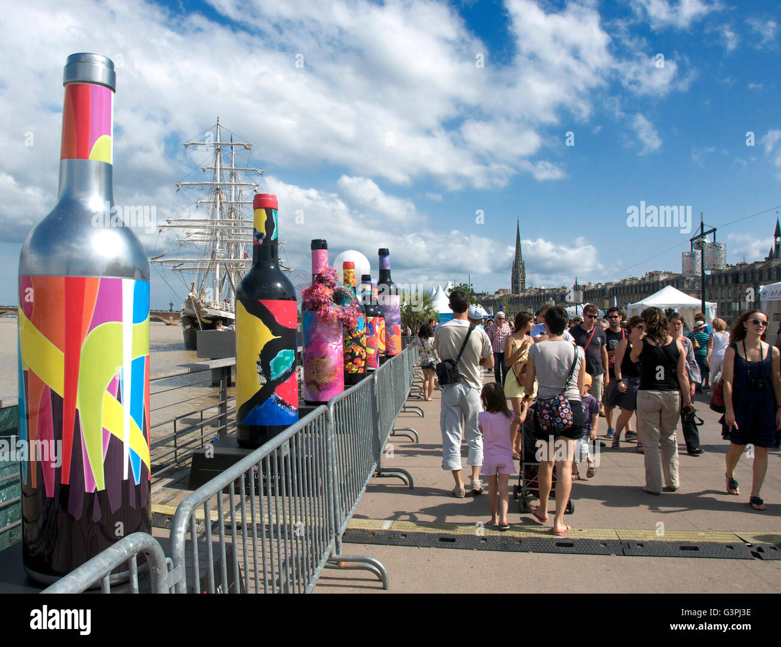
Bordeaux wine tours are renowned all over the world. During the Bordeaux Wine Festival, you can experience almost a kind of a self-guided one, buying in pre-sales or directly there a tasting pass for approximately 20 USD. It includes a wine glass in its case with more than a dozens of tickets to taste some of red and white Bordeaux wines, which are among the greatest wines in the world, such as Pomerol, Saint Emilion and Medoc.

Slide 7
Beaujolais nouveau festival
As far back as the 1800s, Beaujolais growers would gather to celebrate the end of the harvest by toasting the vintage with some of the young wine produced that year
This "Beaujolais Day" is accompanied by publicity events and heavy advertising. The traditional slogan, even in English-speaking countries, was "Le Beaujolais nouveau est arrivé!" (literally, "The new Beaujolais has arrived!"), but in 2005 this was changed to "It's Beaujolais Nouveau Time!". In the United States, it is promoted as a drink for Thanksgiving, which always falls exactly one we

Slide 8
The wine used to be released from France at 12:01 on the third Thursday of November. During the 2000s the release rules started to relax, with the wines shipped ahead of time, and released to local markets at 12:01 a.m. local time. Starting in the 2010s, it started to be sent to retailers ahead of the third Thursday, with instruction not to sell it until the third Thursday.

